Slide 1
Web Systems Midterm Project
Todo Web Application
By Hritwik Dutta, NetID - xc1025

Slide 2
Project Introduction
For the midterm project, I have created a simple ToDo Web Application using which one can keep a track of the tasks that they need to take care of.
The functionality implemented includes adding a new todo item, deleting an existing todo item and updating any one of the todo items.
Please find attached some screenshots about the look and feel of the application, along with its working after the database details.
Since black is my favorite color, I have gone for a simple black and white based design theme for my app.

Slide 3
Technologies Used
All of the above is implemented using Java servlets and jsp pages for rendering the HTML on the browser.
A single JavaScript functionality has also been implemented, which checks for empty input on all three fields while adding a new ToDo item.
A combination of Bootstrap, inline styling and external style sheets have been used for the styling the website.

Slide 4
Database Details
In order to keep a track of all the todos and to facilitate smooth data handling, a MySQL database has been connected with the webapp.
For more details on the setup of the database, please refer to the file DBConnect.java
In order to install and run the web application on a local system, please ensure that the second and third parameters for the DriverManager.getConnection method are the username and password used for accessing the database.

Slide 5
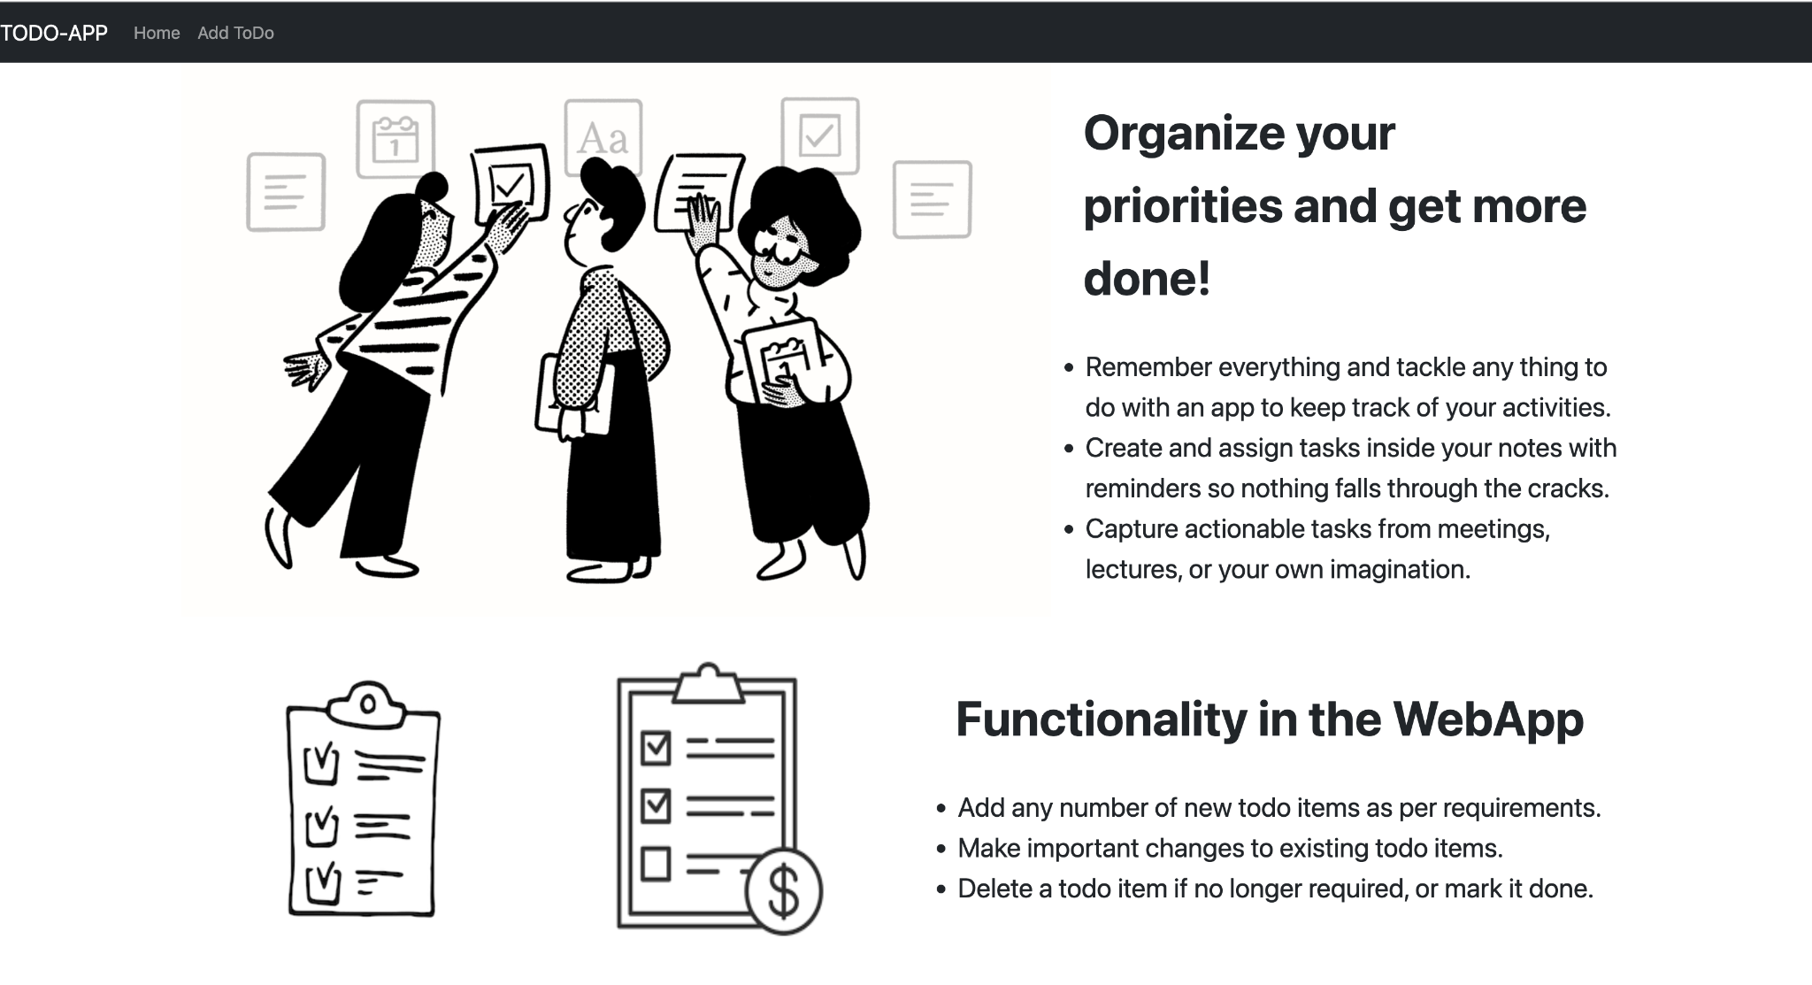
WebApp Home page

Slide 6
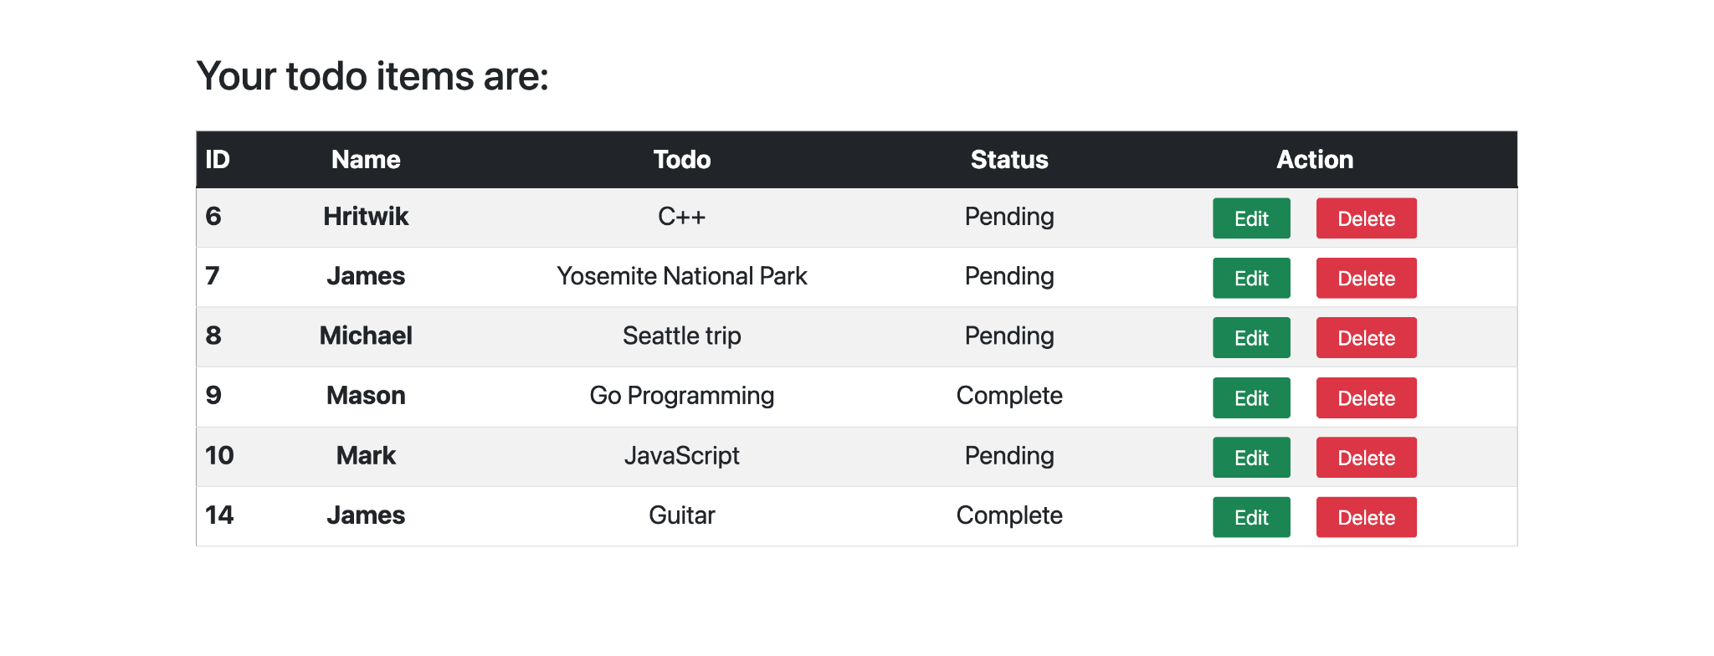
Home Page footer

Slide 7
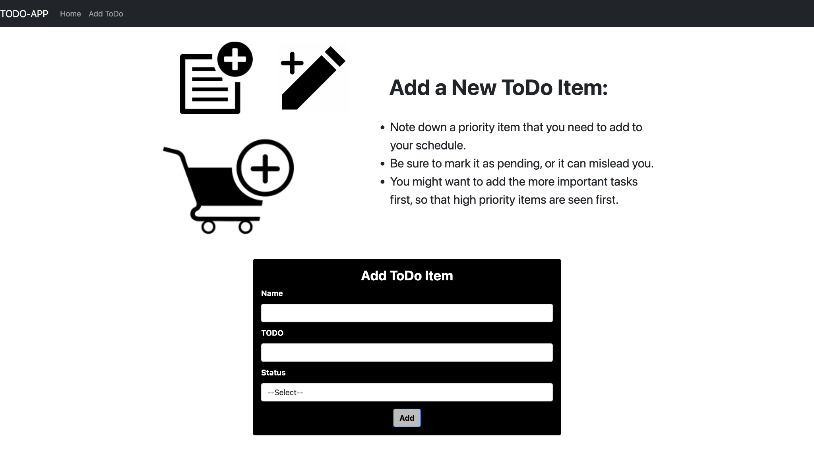
Add a new item

Slide 8
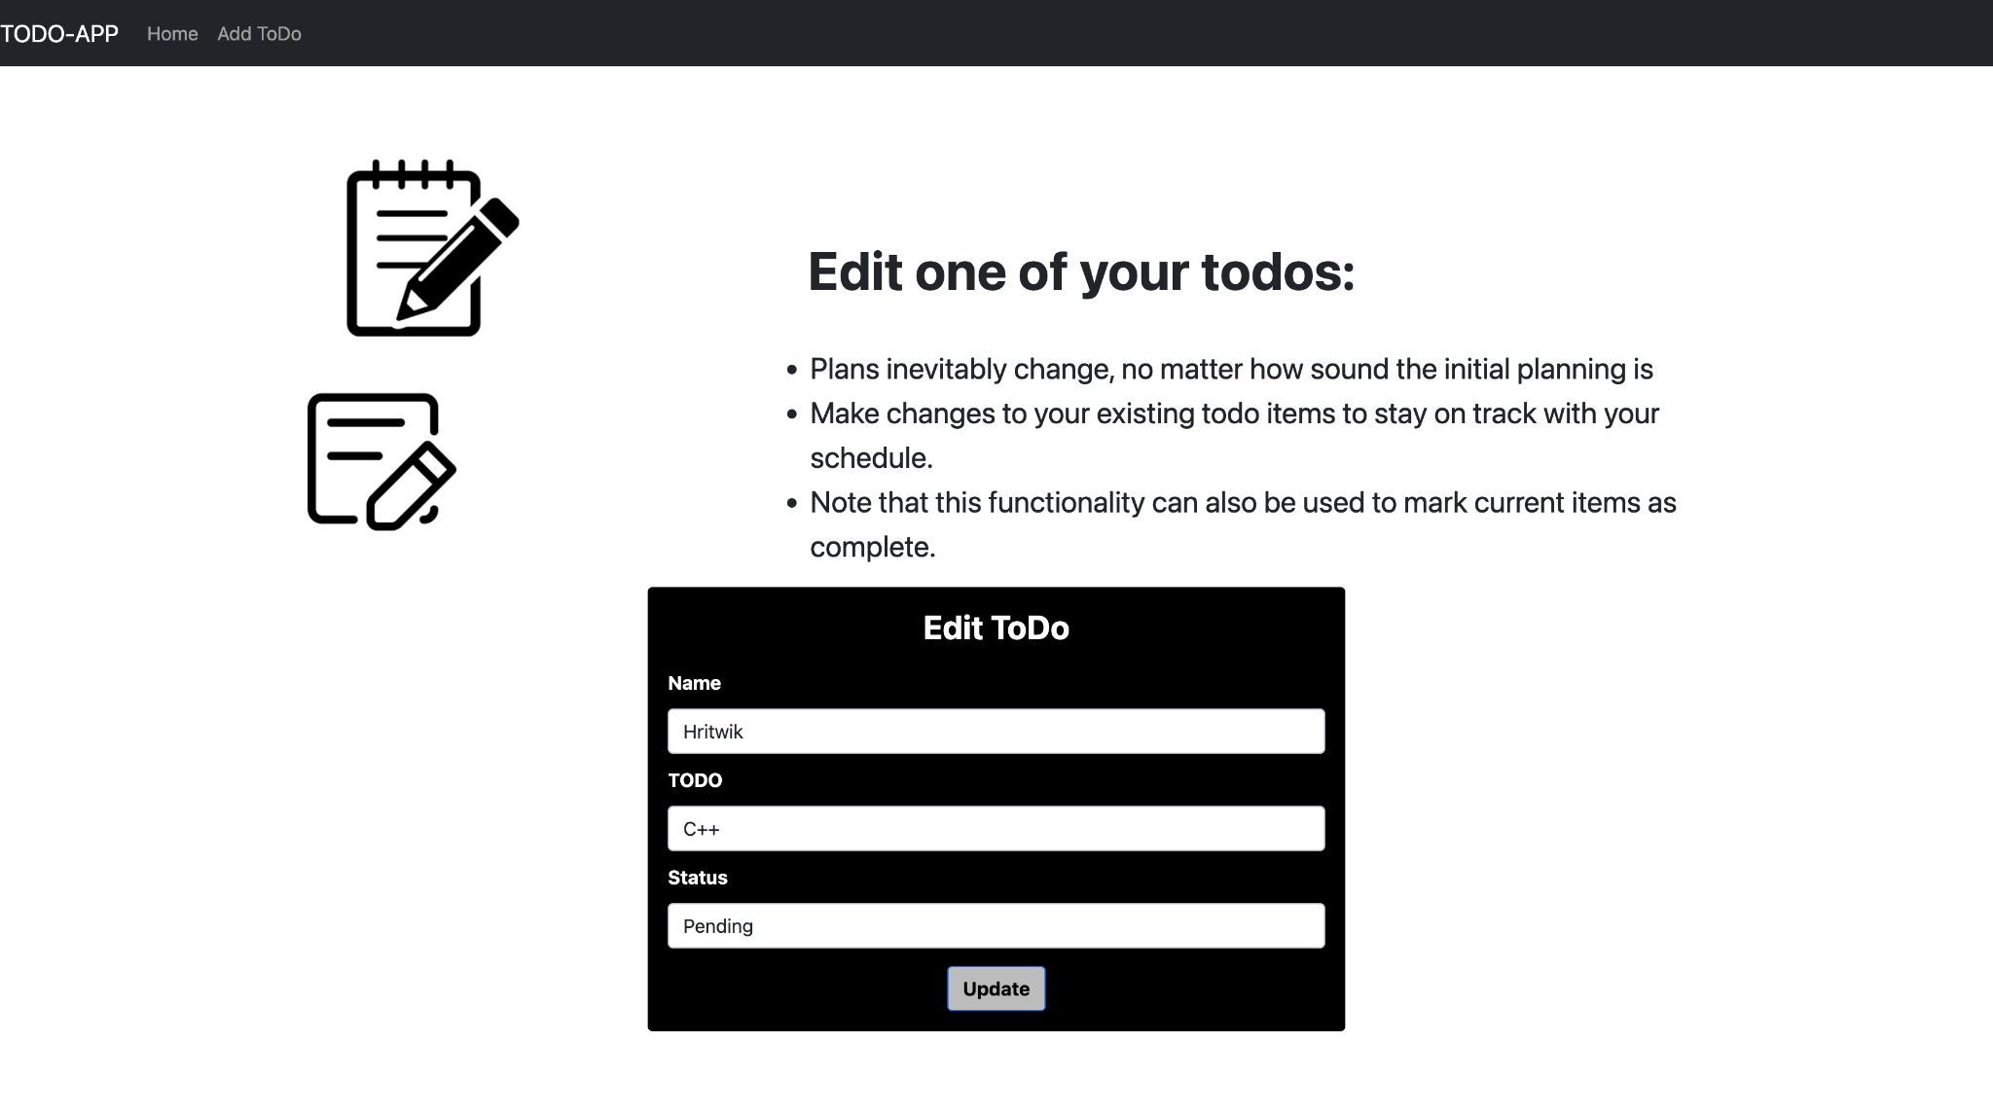
Update an existing item

Slide 9
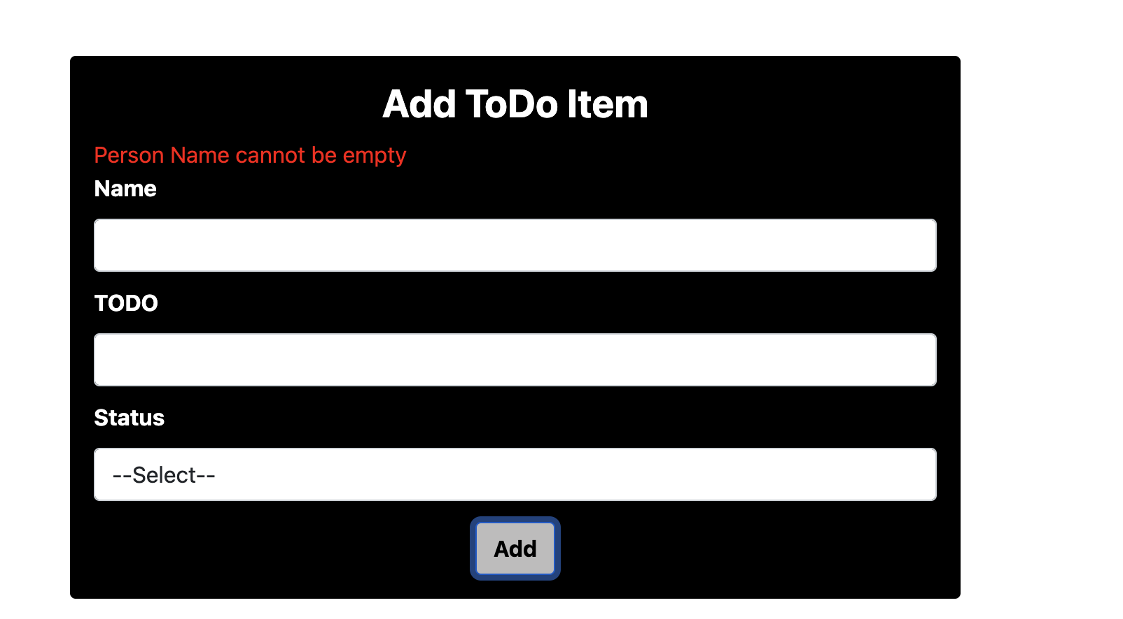
Validation while adding item I

Slide 10
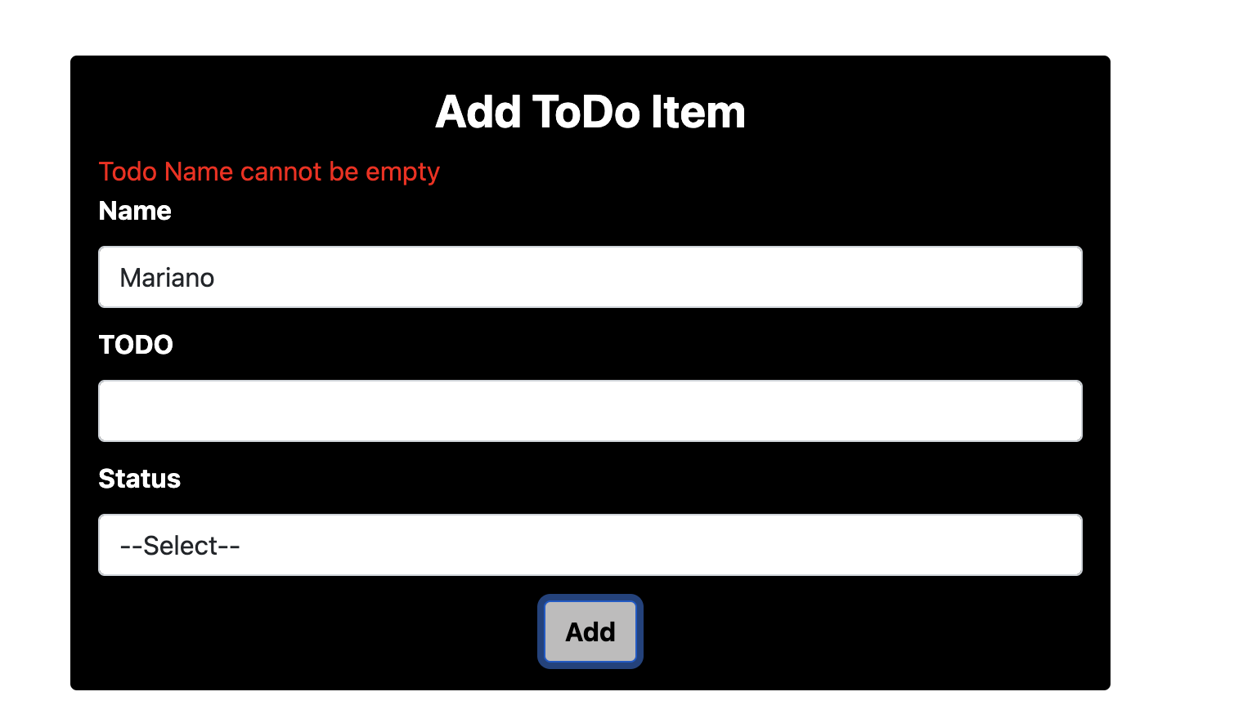
Validation while adding item II

Slide 11
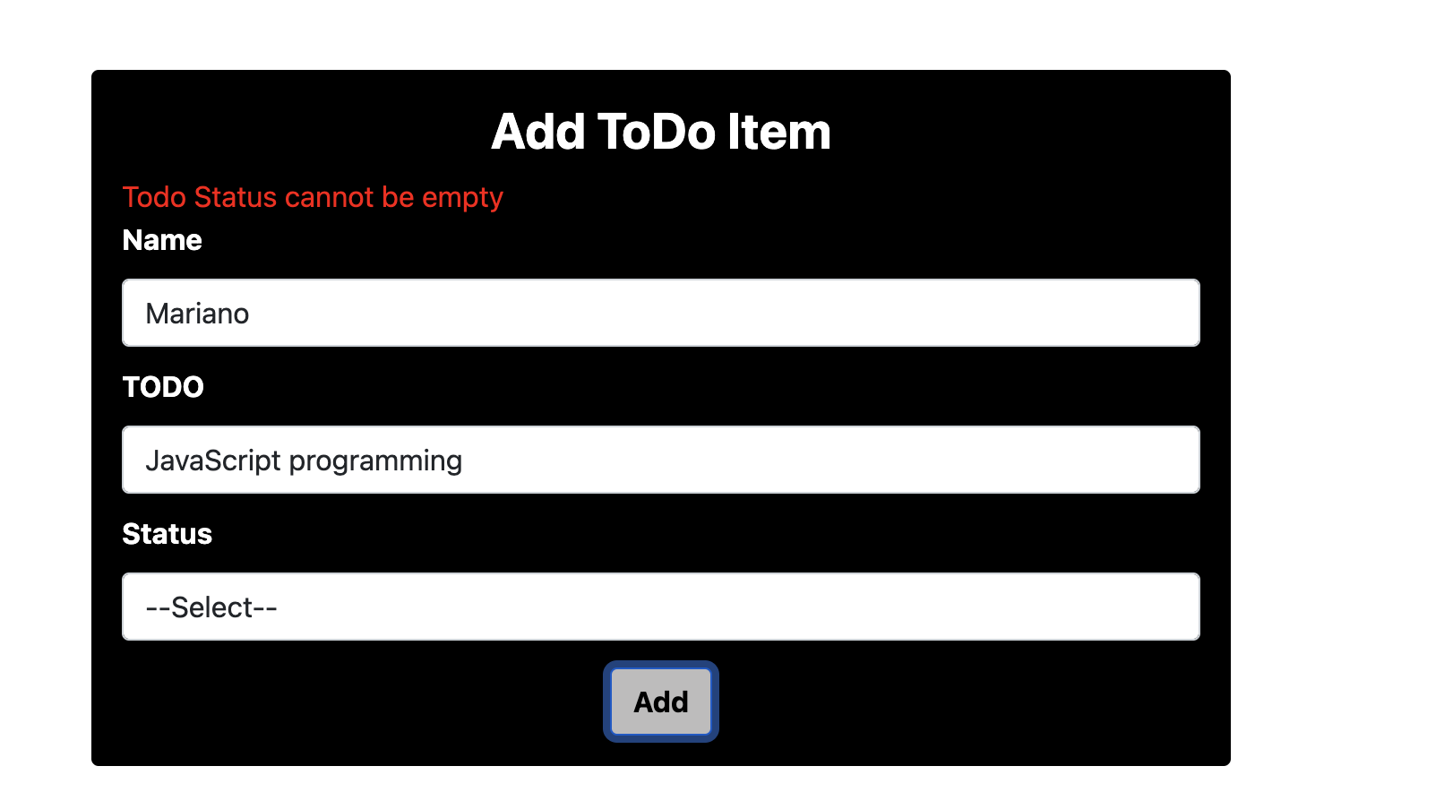
Validation while adding item III

Slide 12
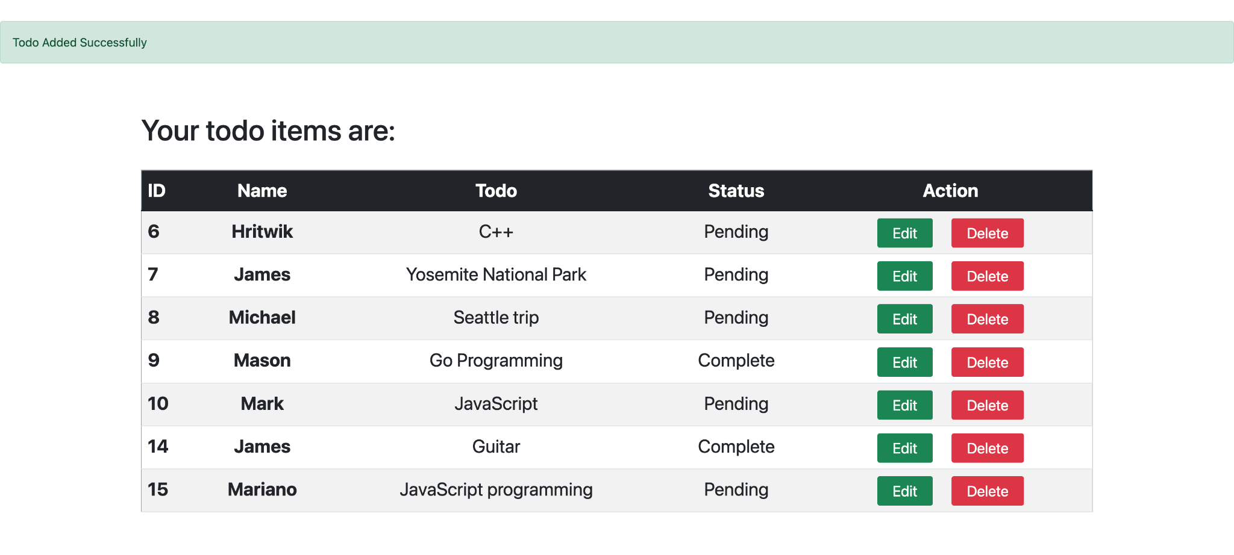
Successful addition of a new item

